Slide 1
Abstract algebra ch 25 finite simple groups

Slide 2
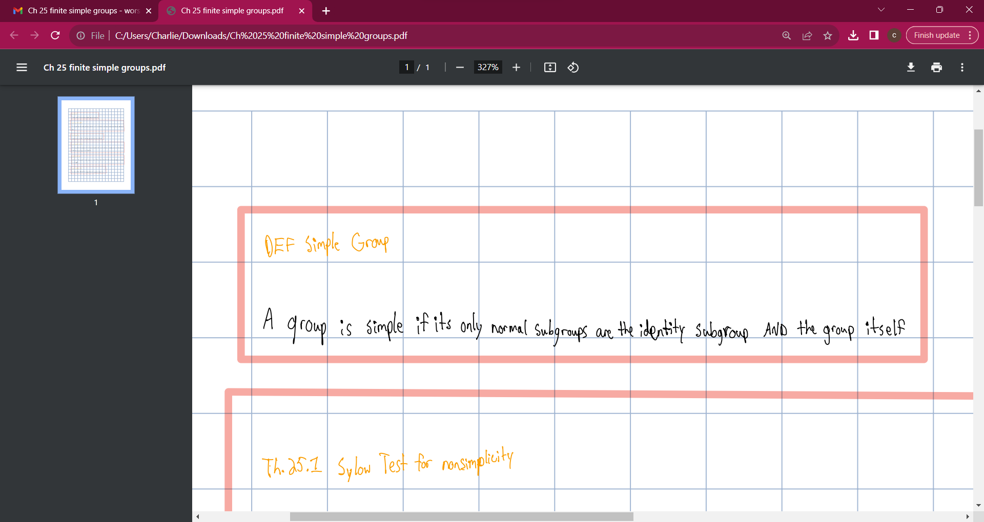

Slide 3
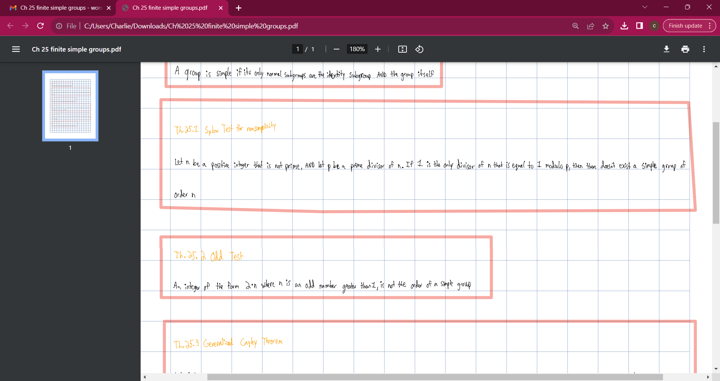

Slide 4
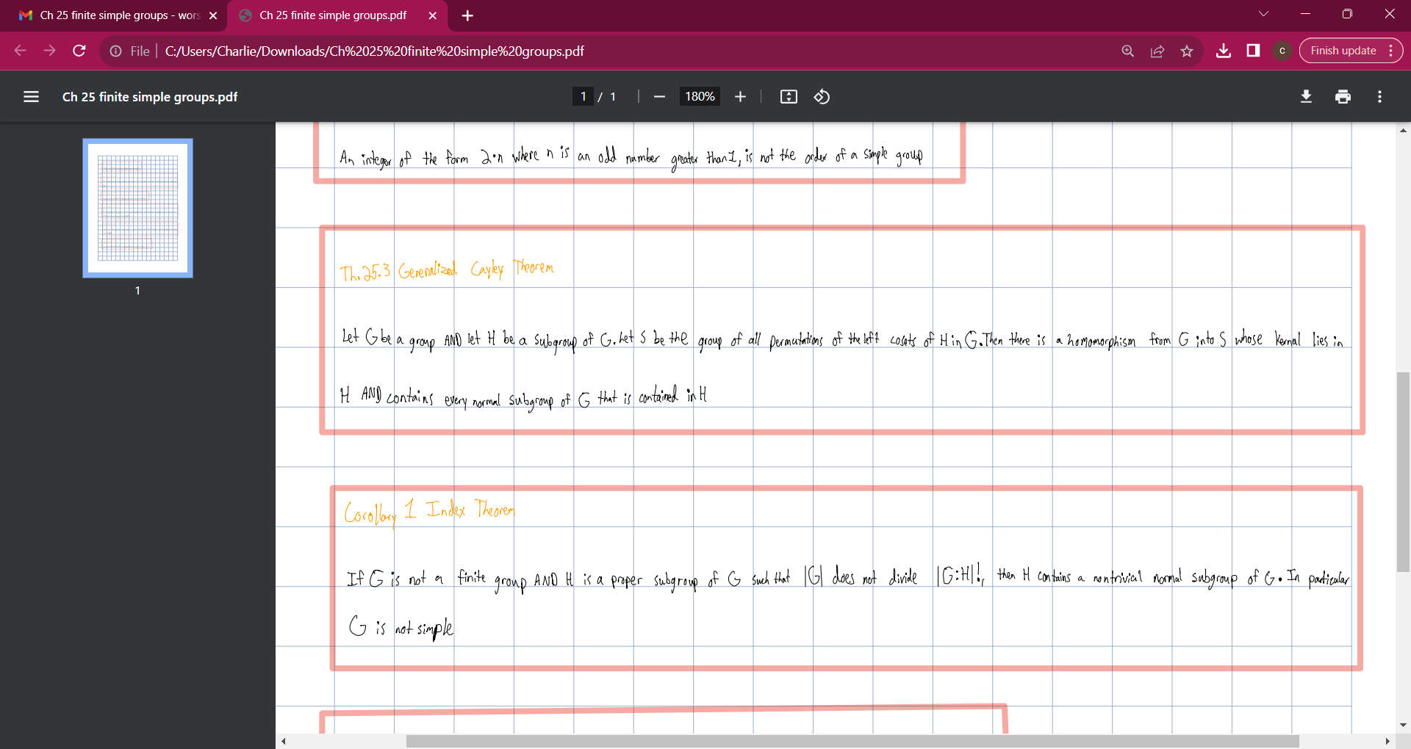

Slide 5
